Slide 1
07.01.2025
Pascal

Slide 2
unfolding event rate no systematics

Slide 3
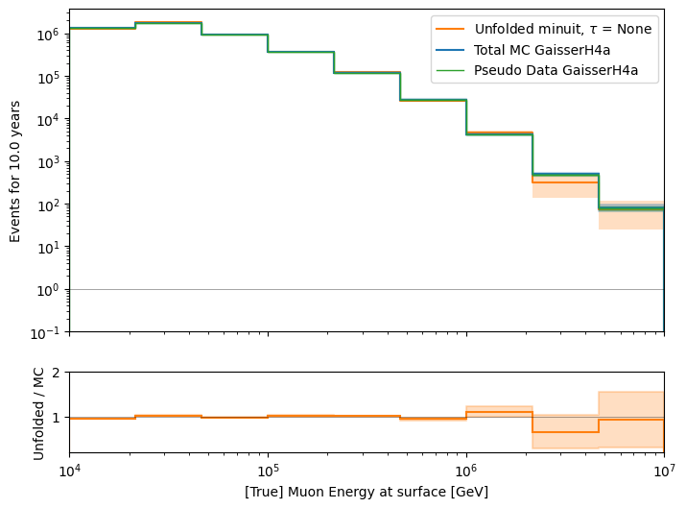
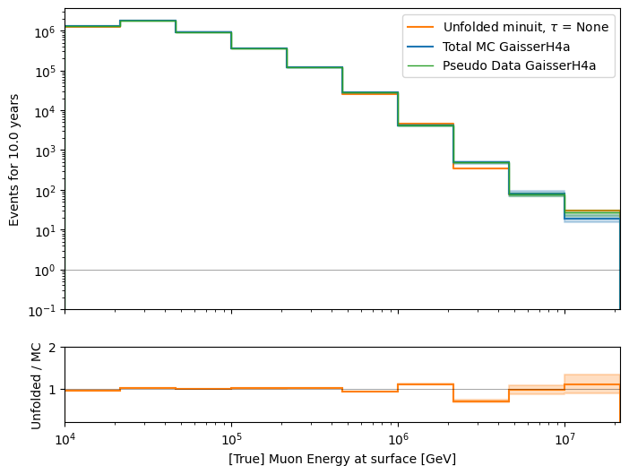
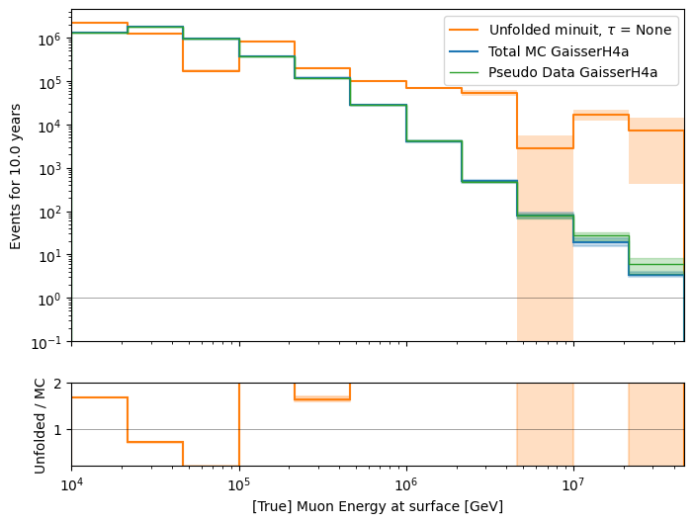
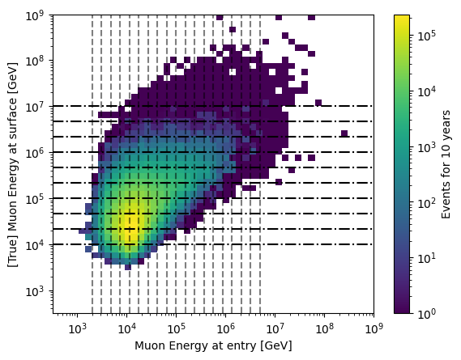


extend unfolding bins, keep proxy bins
+1 bin
+2 bins

Slide 4
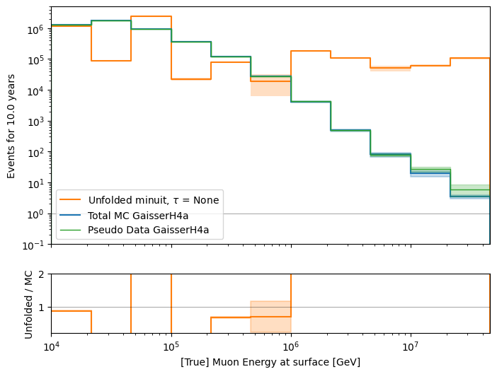
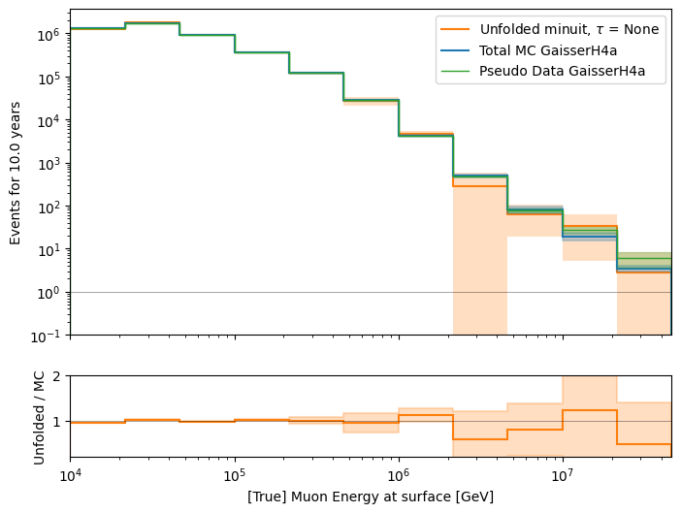
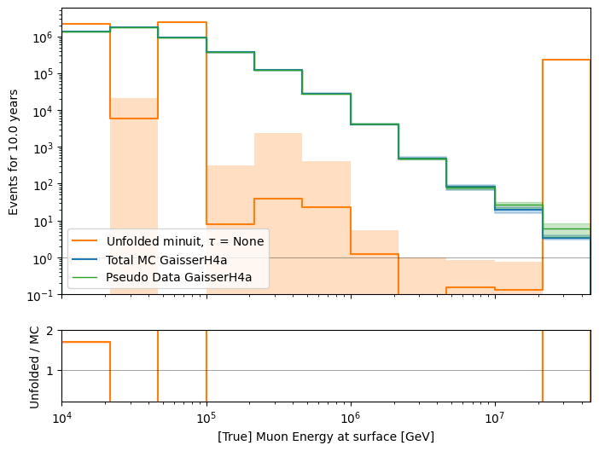



extend unfolding bins, extend proxy bins
+2 unf bins, +1 proxy bin
+2 unf bins, +2 proxy bins
+2 unf bins, +3 proxy bins

Slide 5
unfolding event rate with systematics
linear fit with 3 data points

Slide 6
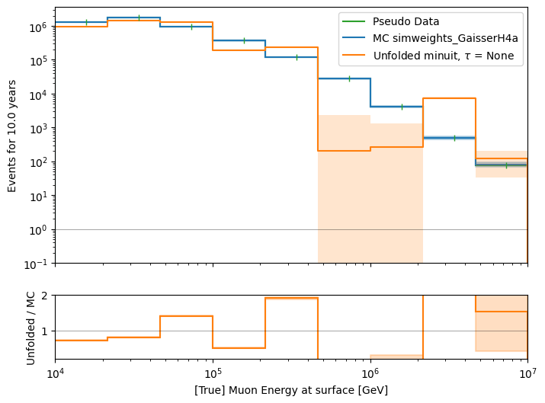
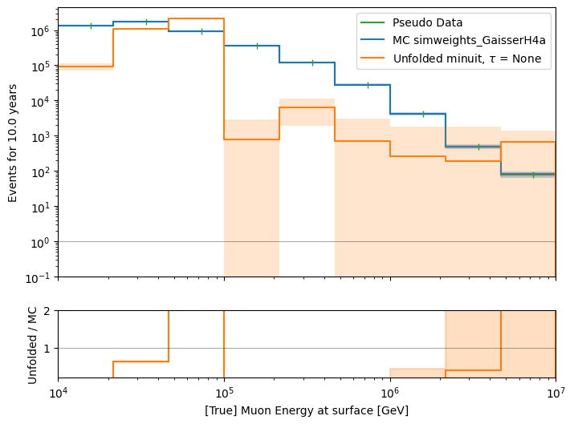
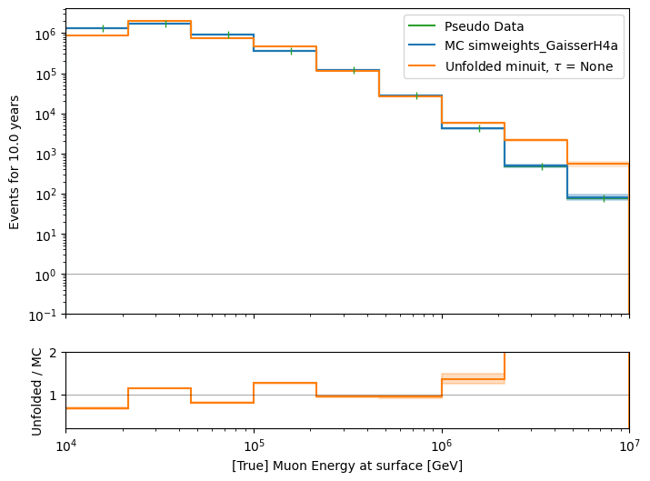
scattering & absorption
x0 = [1e5, …,1, 1], bouns = None
x0 = None, bounds = None
x0 = [True values, 1, 1], bounds = None
invalid minimum
invalid minimum
invalid minimum

Slide 7
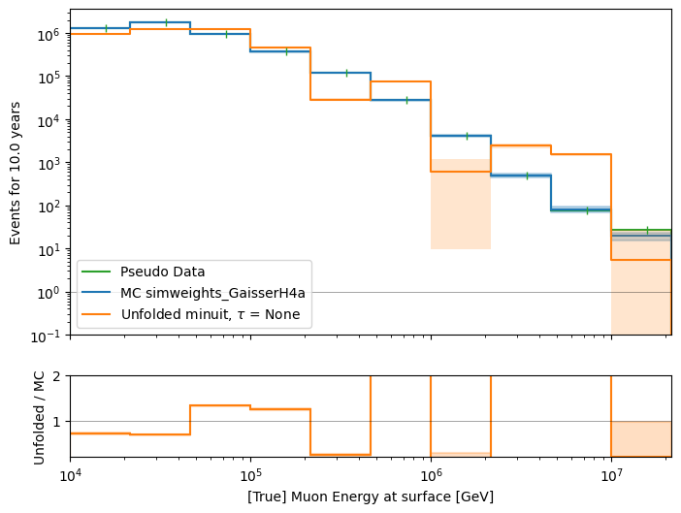
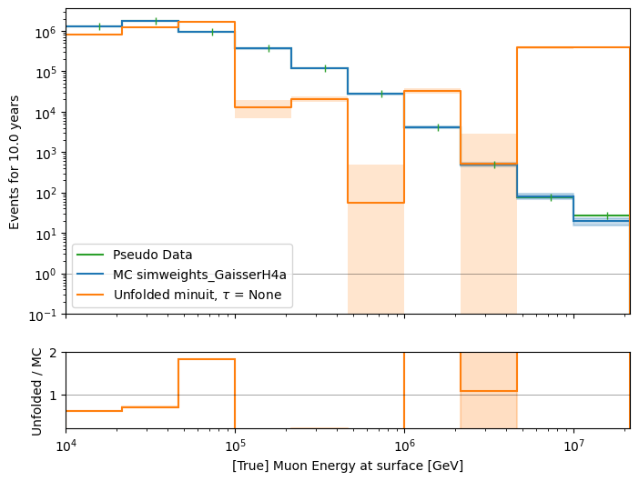
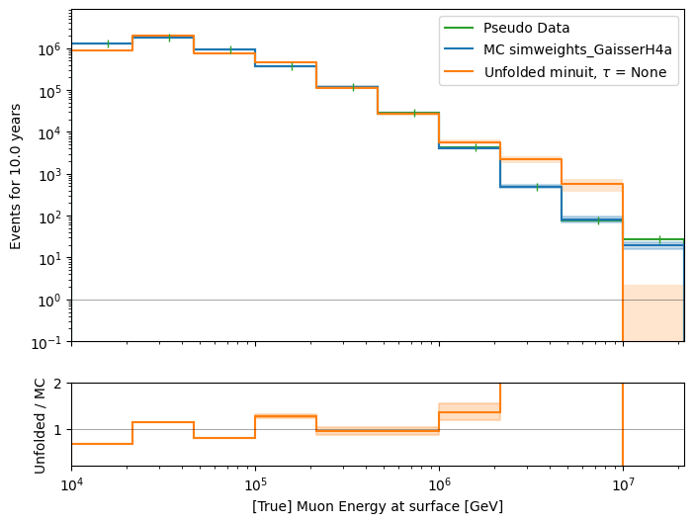
scattering & absorption, +1 unfolding bin
x0 = [1e5, …,1, 1], bouns = None
x0 = None, bounds = None
x0 = [True values, 1, 1], bounds = None
invalid minimum
invalid minimum
valid minimum

Slide 8
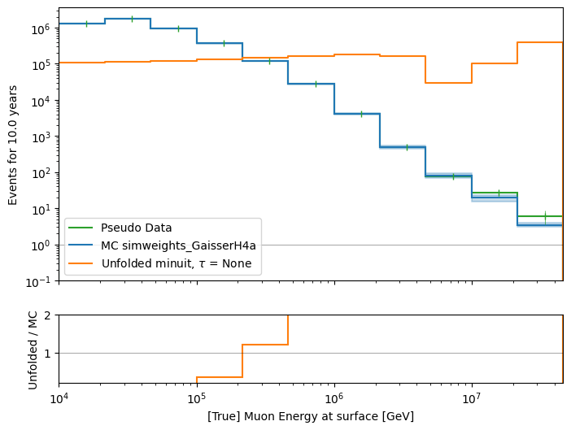
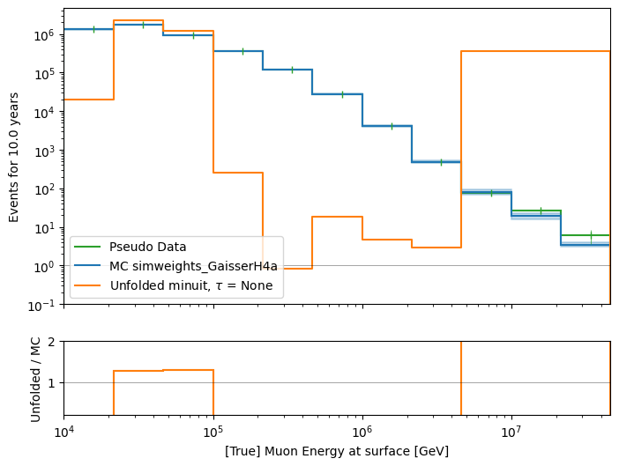
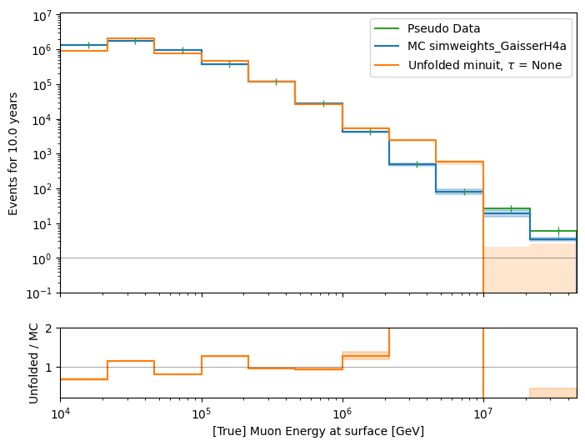
scattering & absorption, +2 unf bins, +2 proxy bins
x0 = [1e5, …,1, 1], bouns = None
x0 = None, bounds = None
x0 = [True values, 1, 1], bounds = None
invalid minimum
invalid minimum
invalid minimum

Slide 9
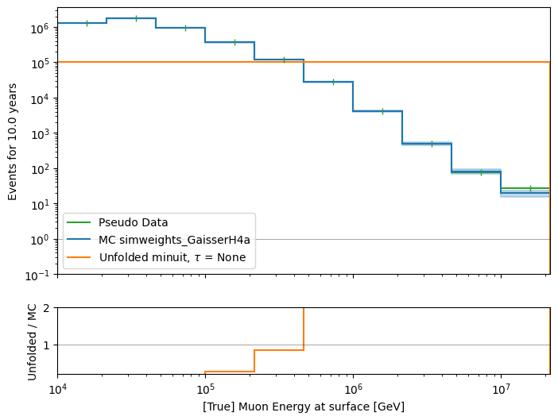
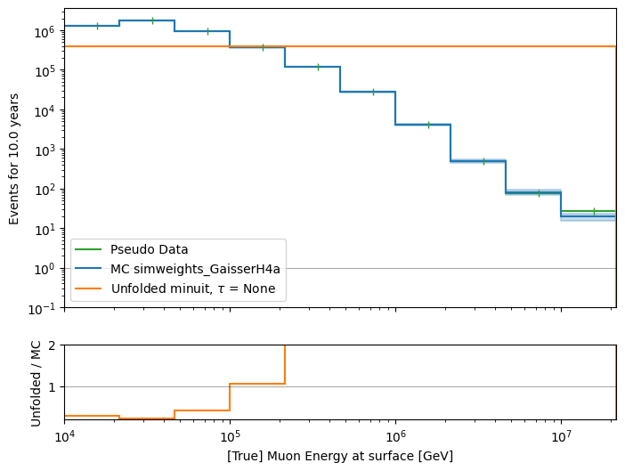
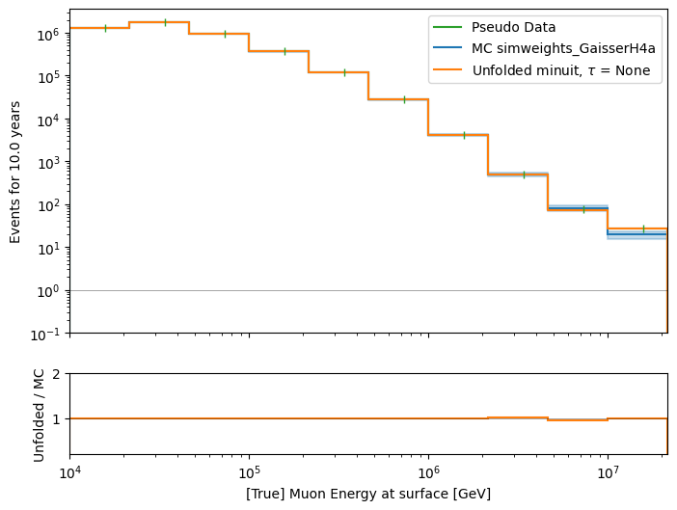
5 systematics, +1 unfolding bin
x0 = [1e5, …,1, 1, 1, 0.2, -0.05], bouns = None
x0 = None, bounds = None
x0 = [True values, 1, 1 , 1, 0.2, -0.05], bounds = None
invalid minimum
invalid minimum
invalid minimum

Slide 10
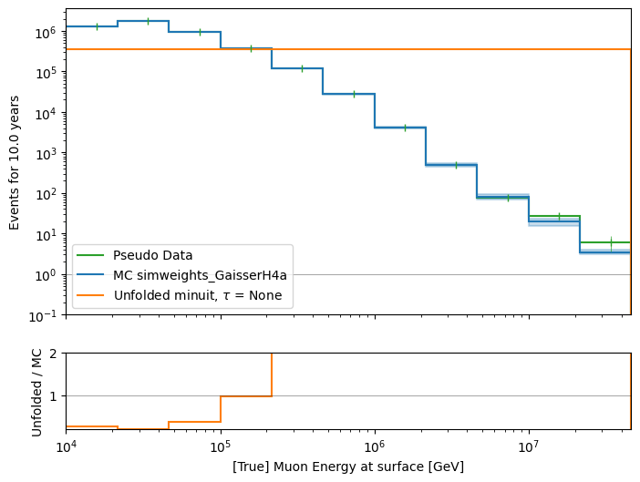
5 systematics, +2 unf bins, +2 proxy bins
x0 = [1e5, …,1, 1, 1, 0.2, -0.05], bouns = None
x0 = None, bounds = None
x0 = [True values, 1, 1 , 1, 0.2, -0.05], bounds = None
invalid minimum
invalid minimum
invalid minimum

Slide 11
